Slide 1
SWISSBOT (Reinforcement Learning framework for TF2 AI)
Senior Design Project by Tristan McGinnis
Advised by Fred Annexstein

Slide 2
Goals
PRIMARY OBJECTIVE: To create a reinforcement learning framework that allows AI bots to interact with and learn from Team Fortress 2’s (TF2) in-game environment. This project will allow basic movement or aiming behaviors through neural feedback loops.
SECONDARY OBJECTIVE: To reach a model that is capable of not only responding to in-game terrain and obstacles, but identifying combatants and retaliating with appropriate strategy.
Bonus objective: Teaching Swissbot to calculate and destroy enemies' mid-air (a challenging feat for human players).

Slide 3
Goals (Cont.)
Background: Team Fortress 2 (2007) is a multiplayer class-based FPS built on Valve’s Source Engine. The game features dynamic physics, trajectory-based combat, and teamwork-oriented gameplay (…sometimes).
Valve is extremely supportive of its modding scene, which this project utilizes to place AI training tools into a live game server for reinforcement training. Various mod tools and plugins allows for custom maps and levels better suited for a training environment.

Slide 4
Intellectual Merits
Cross-Disciplinary Integration: Swissbot combines reinforcement learning (via Tianshou), game engine plugin development (SourceMod, Metamod:Source), and custom bot behaivor scripting (RCBot2) to make this project function.
Systems-Level Engineering: This project involves real-time interaction between Python, C++, and SourcePawn for plugin messaging and data collection.
Legacy Engineering: The proprietary software and tools used are well over twenty-years old. Many DLLs needed to be updated, fixed, and recompiled for TF2’s transition from a 32-bit to a 64-bit application.

Slide 5
Broader Impacts
General research for how AI learns to makes optimal decisions in real-time virtual environments.
A stable and low-resource environment for experimenting with simple AI behaviors and strategies in games.
Allows for insight into greater game balance and theory, used to determine if elements of gameplay are both engaging and innovative even at its most optimized.
Proximal Policy Optimization (PPO) as a RL algorithm can be used to quickly train any sort of AI in relation to movement/location based tasks.

Slide 6
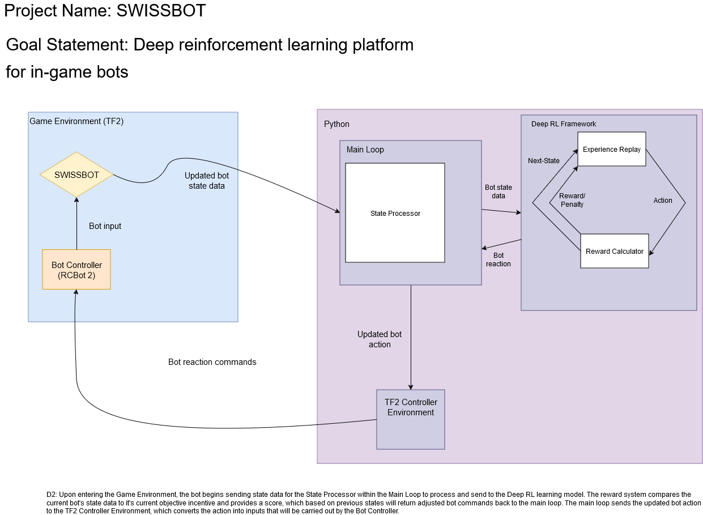
Design Specifications (prev.)

Slide 7
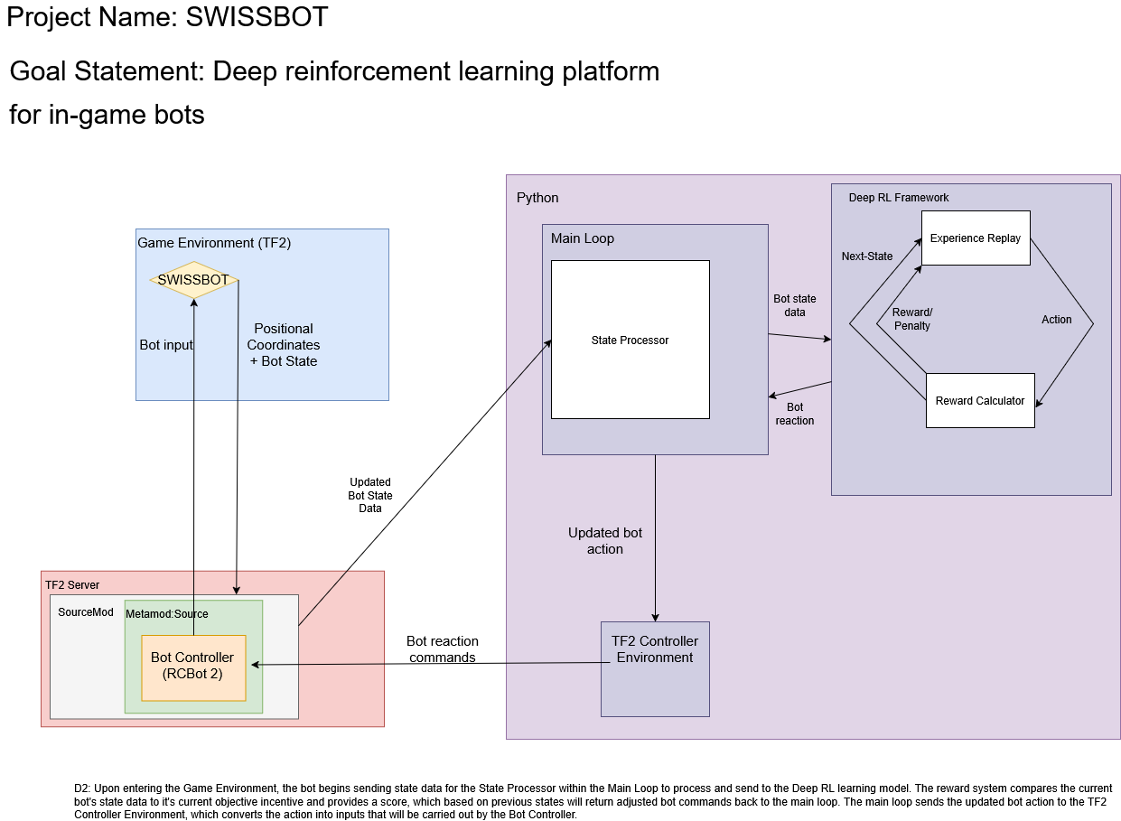
Design Specifications (updated)

Slide 8
Technologies
Team Fortress 2: Multiplayer FPS with modding support + testbed
Tianshou: Python library for Reinforcement Learning.
RCBot2: Custom bot framework for TF2, handles movement and action dispatching.
Metamod:Source: Core plugin interface/container for Source engine games. Injects custom logic into TF2.
SourceMod: Scripting layer for game server logic, used to read game info and trigger bot actions by communicating with external programs.
SourcePawn: Valve’s proprietary server scripting language used for the creation of server plugins.
Languages: C++, Python

Slide 9
Milestones
First Semester
Researched Tianshou + RL algorithms
Created a dedicated TF2 server and created a testing environment
Integrated (then) working version of Metamod:Source + SourceMod
Second Semester
Manually updating a fork of Metamod:Source to be compatible with updated TF2 server infrastructure
RCBot2 updated and installed for 64-bit server infrastructure
Established connection between now functioning TF2, RCBot2, Metamod:Source, SourceMod and established basic connection to the beginning of Tianshou implementation.

Slide 10
Results
Metamod:Source (ver. dev 1155-6) has been reprogrammed and rebuilt for a 64bit application and is now compatible with all parallel applications.
TF2 Testing server was created from scratch and was optimized for a proper testing environment.
Verified that bots respond to formerly outdated server-side scripting via an updated RCBot2 (Thank you bots-united.com)
Established a modern, working connection between Tianshou and RCBot2, allowing for inputs from Python and for RL to begin.

Slide 11
Challenges
In August of 2024, TF2 was updated to now run as a 64-bit application which resulted in many legacy plugins to cease functioning.
The need to rebuild and recompile plugins for the modern version of TF2 stood in the way of time spent testing a working RL bot.
TF2’s modding scene is nearly eighteen years old, while general scripting and modification documentation is great, bug fixing consists of sifting through abandoned forum pages.
Timing constraints meant most of the project was spent updating legacy software instead of training Swissbot as hoped.

